Slide 1
Data Types and Convercion.
Type Conversion
By Vadum Revula
Notes:
<number>

Slide 2
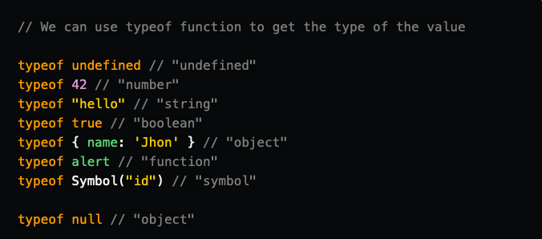
Data Types
Number
String
Boolean
Object
Function
Undefined
Symbol
The null value of course is not an object though. Its type is "null". Yet for the historical reasons typeof function returns "object" for the null value.

Slide 3
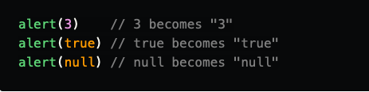
String type conversion
String type conversion applies when the given value is expected to be a string. The most basic example is the alert function:

Slide 4

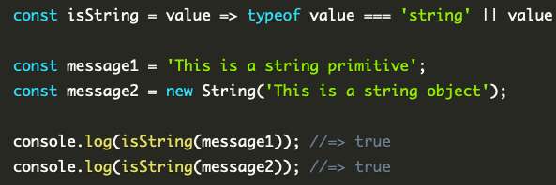
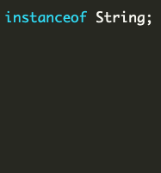

typeof and instanceof

Slide 5
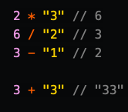
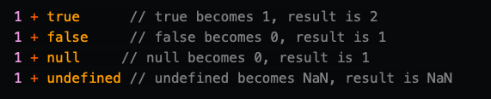
Number type conversion
Number type conversion can be met in the math expressions and comparisons.
The + operator actually works a bit differently. If one of the operands is a string, then all other operands are converted to string too and it works like string concatenation, not like the math expression

Slide 6


Numbers

Slide 7

Boolean type conversion
This type of conversion happens in logical operations. It follows strict rules too yet they are mostly obvious:
0, NaN, undefined, null, "" are converting to false
everything else, including objects, to true

Slide 8
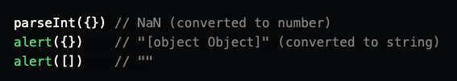


Type conversions for objects
What JavaScript is going to do if it needs to convert an object to string or number?

Slide 9
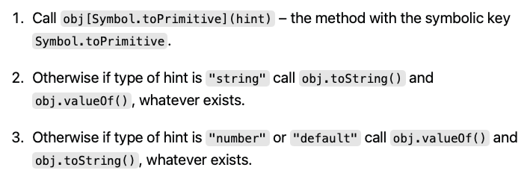
When converting the object type (not array), JavaScript tries to find and call three object methods:

Slide 10

Comparison and type conversion
When doing a non-strict comparison Javascript converts operands to numbers if operands have different type:

Slide 11

Comparison and type conversion
null == undefined! There isn't any type of conversion here and these values have a different types! Yet in non-strict comparison undefined equals null and undefined by design:

Slide 12
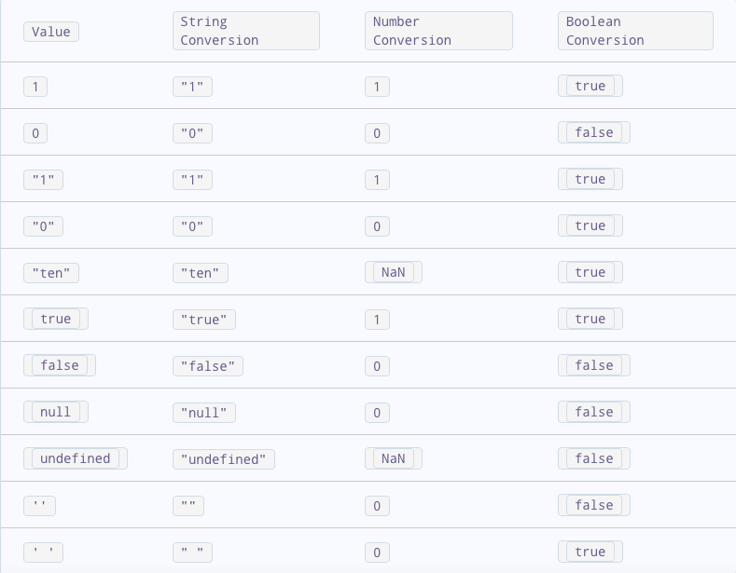
Javascript converts the value to the expected type following specific rules.

Slide 13
Conclusion
In JavaScript, different data types require distinct forms of checking.
Strings, numbers, booleans and functions can be easily checked by using the typeof operator.
For null and undefined, you can use a simple comparison with the strict equality operator.
Arrays can be recognized by using the Array.isArray static method
We have special functions such as isNaN and isFinite, for us to check numeric values like NaN, Infinity and -Infinity

Slide 14


